Slide 1
AMAZON SALES DASHBOARD USING POWER BI
-SHRISTI BHARDWAJ

Slide 2
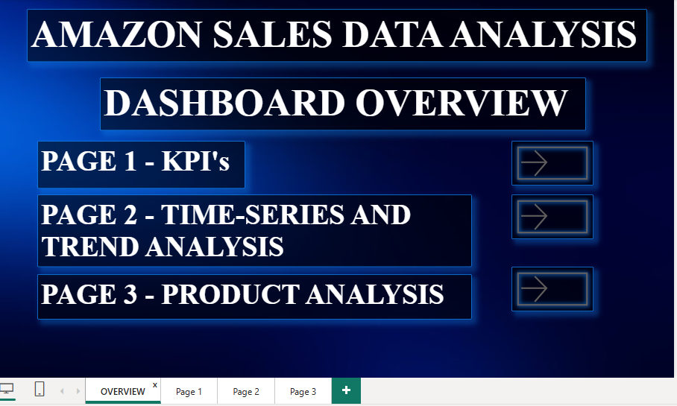
PAGE SUMMARY
The first page consist of index.
It includes button in front of each page’s title and the button navigates to the page. (page navigation)
First page gives and overview of what one can expect from the report
Each page covers a particular topic and index gives an insight to that.

Slide 3
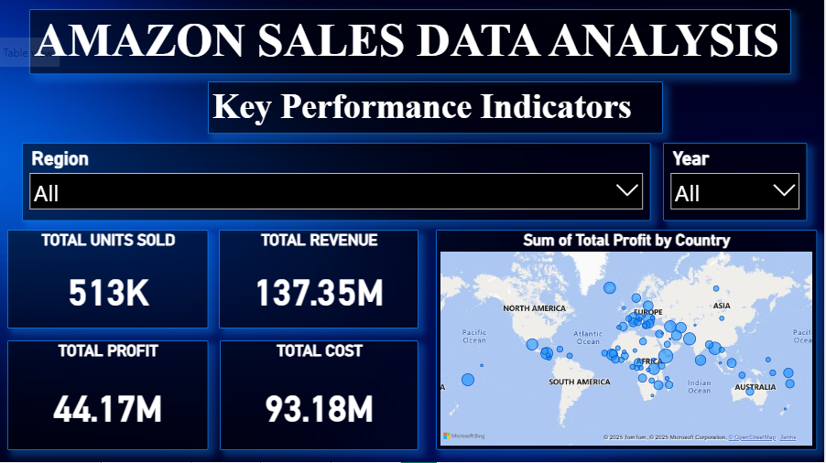
KEY PERFORMANCE INDICATORS
Page 1 consist of cards with KPI cards of Total profit , units sold, etc.
It also has slicers for year and region.
Choosing a particular year or region we can get the profit or revenue of that particular entity.
It has a bubble map which gives profit by country.

Slide 4
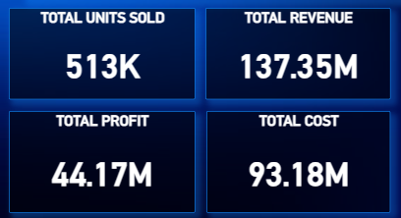
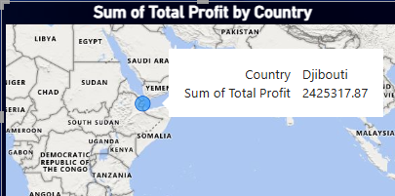
PAGE 1 - ANALYSIS
TOTAL PROFIT: 44.17M
TOTAL UNITS SOLD: 513K
TOTTAL REVENUE: 137.35M
TOTAL COST: 93.18M
REGION WITH MAXIMUM PROFIT: SUB-SAHARAN AFRICA
REGION WITH MINIMUM PROFIT: NORTH AMERICA
YEAR WITH MAXIMUM PROFIT: 2012
YEAR WITH MINIMUM PROFIT: 2011
COUNTRY WITH MAXIMUM PROFIT: DJIBOUTI

Slide 5
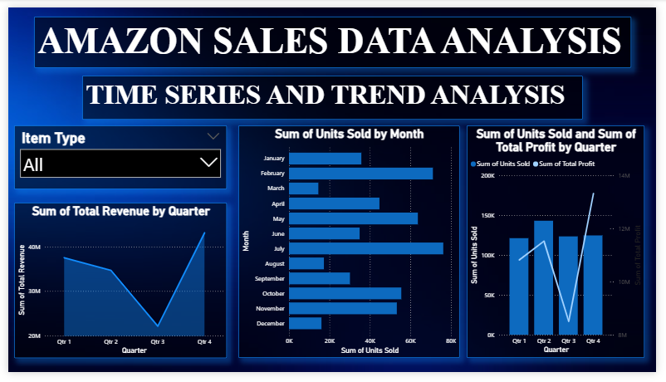
TIME SERIES AND TREND ANALYSIS
Page 2 consist of graphs which analyze the trends overtime.
It also has slicers for item type.
Choosing a particular item , we can get the trends on graph of that particular entity.
It includes monthly and quarterly analysis.

Slide 6
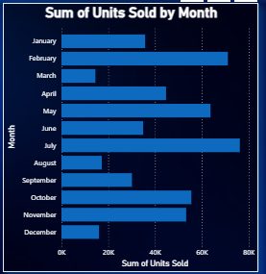
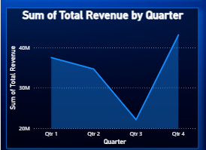
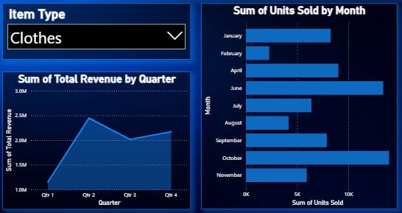
PAGE 2 - ANALYSIS
OVERALL LEAST REVENUE: Q3
MAXIMUM REVENUE: Q4
MONTH WITH MAX UNITS SOLD: JULY
MINIMUM UNITS SOLD: MARCH
ITEM SOLD FOR MAXIMUM MONTHS: CLOTHES
ITEM SOLD FOR LEAST NUMBER OF MONTHS: MEAT

Slide 7
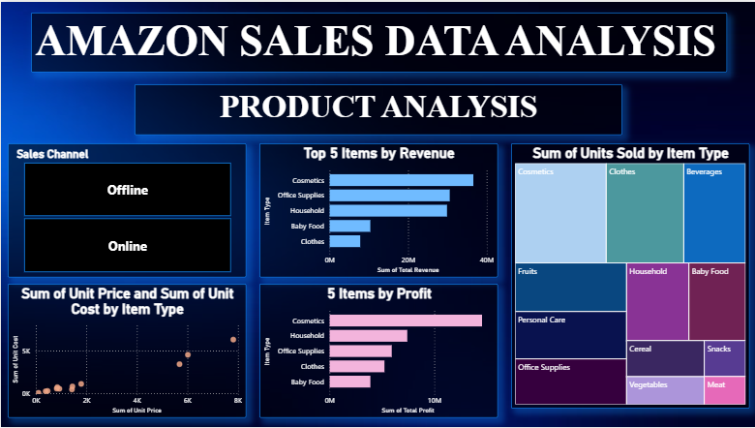
PRODUCT ANALYSIS
Page 3 consist of graphs which analyze the sales via item type.
It also has slicers for sales channel: online and offline.
Choosing a particular channel , we can get the trends on graph of that particular channel.
It includes scatter and tree map which helps in better analysis.

Slide 8
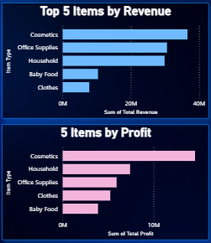
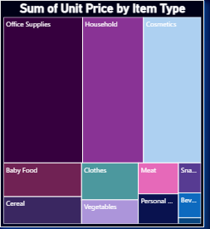
PAGE 3 - ANALYSIS
ITEM WITH MAX REVENUE: COSMETICS
ITEM WITH MAX PROFIT: COSMETICS
ITEM WITH MIN REVENUE: CLOTHES
ITEM WITH MIN PROFIT: BABY FOOD
ITEM WITH MAX UNIT PRICE: OFFICE SUPPLIES
ITEM WITH MIN UNIT PRICE: FRUITS
ITEM WITH MAX PROFIT ONLINE: COSMETICS
ITEM WITH MAX PROFIT OFFLINE: HOUSEHOLD

